Slide 1

Non-linear SVM
Professor Bo Liu
James Watt School of Engineering

Slide 2
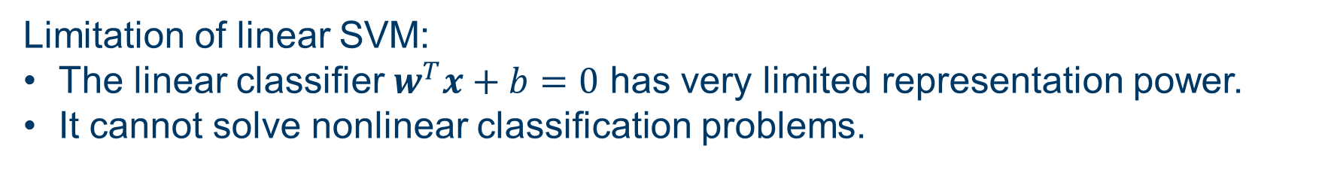
Non-linear SVM
Limitation of linear SVM:
The linear classifier $w^{T}x+b=0$ has very limited representation power.
It cannot solve nonlinear classification problems.
Not linearly separable
Good news: with a slight modification using kernel trick, SVM can solve highly nonlinear classification problems.

Slide 3

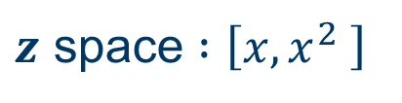
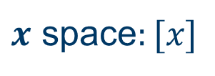


Kernel
Kernels: functions that transform data to required forms
First, map data to higher dimensions where it exhibits linear patterns.
Then, learn a linear classifier in the new input space.
Kernel maps input space to feature space:
Input space: the space where the data exists.
Feature space: the transformed space where data is transformed to be linearly separable.
$$z_{2}$$
1-dimensional case
feature mapping
$$x$$
$x$ space$:[x]$
$$z_{1}$$
$z$ space $:\left[x,x^{2} \right]$

Slide 4

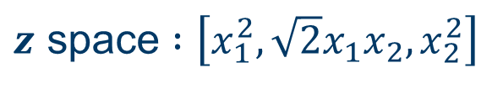




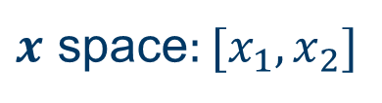
Kernel
Kernel maps input space to feature space:
Input space: the space where the data exists.
Feature space: the transformed space where data is transformed to be linearly separable.
Example in 2-dimensional space
$$z_{2}$$
$$x_{2}$$
Feature mapping
$$z_{1}$$
$$x_{1}$$
$$z_{3}$$
$x$ space$:[x_{1},x_{2}]$
$z$ space $:\left[x_{1}^{2},\sqrt{2}x_{1}x_{2}, x_{2}^{2}\right]$

Slide 5
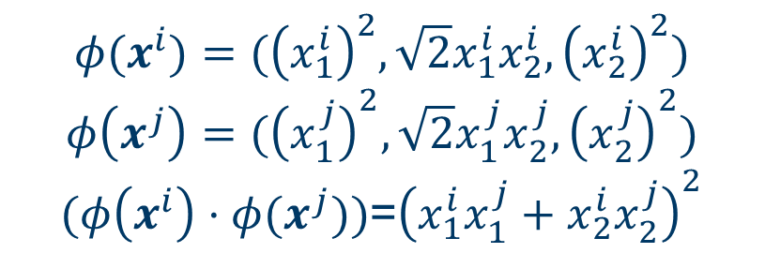
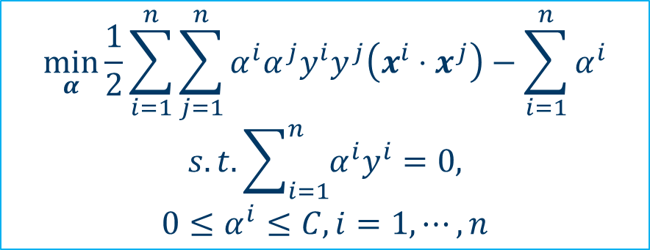

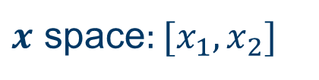
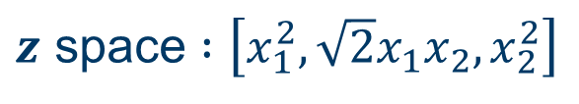

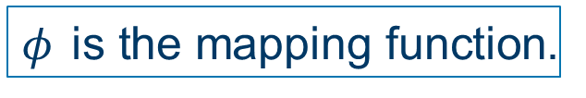
Apply kernel to the dual problem
dual problem of linear SVM
$$\min_{α}{\frac{1}{2}}\sum_{i=1}^{n}{\sum_{j=1}^{n}{α^{i}α^{j}y^{i}y^{j}\left(x^{i}⋅x^{j}\right)−\sum_{i=1}^{n}{α^{i}}}}$$
$$s.t.\sum_{i=1}^{n}{α^{i}y^{i}}=0,$$
$$0≤α^{i}≤C, i=1,⋯,n$$
Through a nonlinear mapping:
$$x^{i}→φ(x^{i})$$
$$x^{j}→φ(x^{j})$$
$$\left(x^{i}⋅x^{j}\right)→(φ\left(x^{i}\right)⋅φ(x^{j}))$$
$φ$ is the mapping function.
$$φ(x^{i})=({\left(x_{1}^{i}\right)}^{2},\sqrt{2}x_{1}^{i}x_{2}^{i},{\left(x_{2}^{i}\right)}^{2})$$
$$φ\left(x^{j}\right)=({\left(x_{1}^{j}\right)}^{2},\sqrt{2}x_{1}^{j}x_{2}^{j},{\left(x_{2}^{j}\right)}^{2})$$
$(φ\left(x^{i}\right)⋅φ(x^{j}))$=${\left(x_{1}^{i}x_{1}^{j}+x_{2}^{i}x_{2}^{j}\right)}^{2}$
Example
$$φ$$
$x$ space$:[x_{1},x_{2}]$
$z$ space $:\left[x_{1}^{2},\sqrt{2}x_{1}x_{2}, x_{2}^{2}\right]$

Slide 6
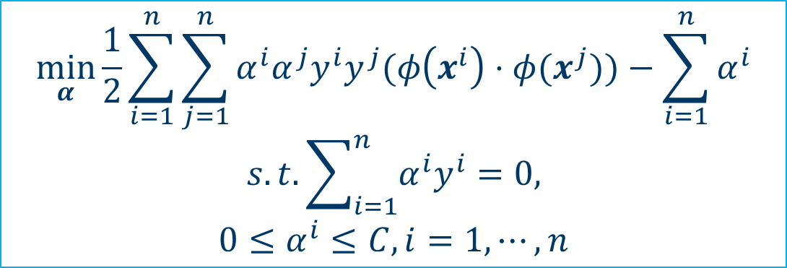

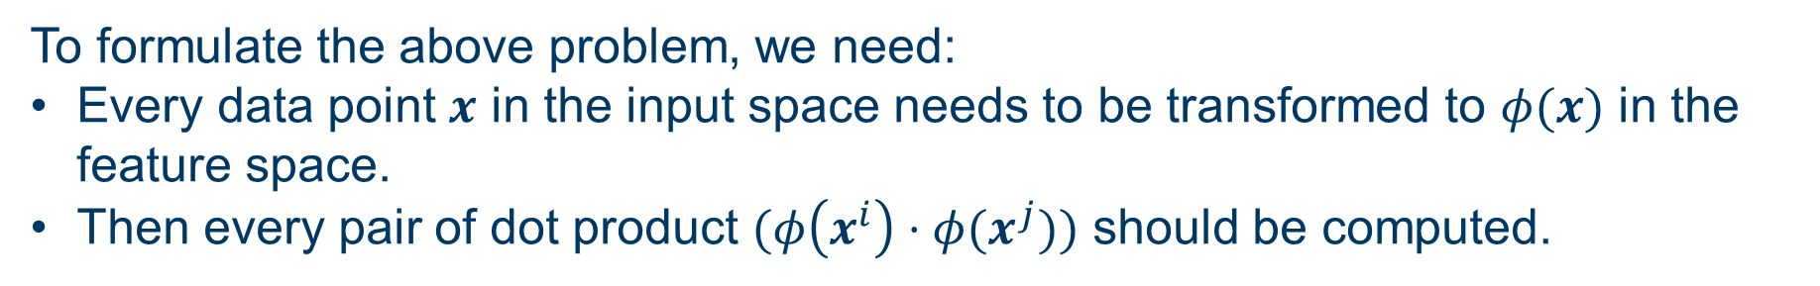
Apply kernel to the dual problem
dual problem of nonlinear SVM
$$\min_{α}{\frac{1}{2}}\sum_{i=1}^{n}{\sum_{j=1}^{n}{α^{i}α^{j}y^{i}y^{j}(φ\left(x^{i}\right)⋅φ(x^{j}))−\sum_{i=1}^{n}{α^{i}}}}$$
$$s.t.\sum_{i=1}^{n}{α^{i}y^{i}}=0,$$
$$0≤α^{i}≤C, i=1,⋯,n$$
$φ$ is the mapping function.
To formulate the above problem, we need:
Every data point $x$ in the input space needs to be transformed to $φ(x)$ in the feature space.
Then every pair of dot product $(φ\left(x^{i}\right)⋅φ(x^{j}))$ should be computed.
The dimension of the feature space is usually much larger than the input space.
The above steps will be very time and memory consuming!

Slide 7
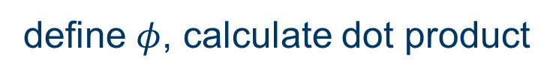
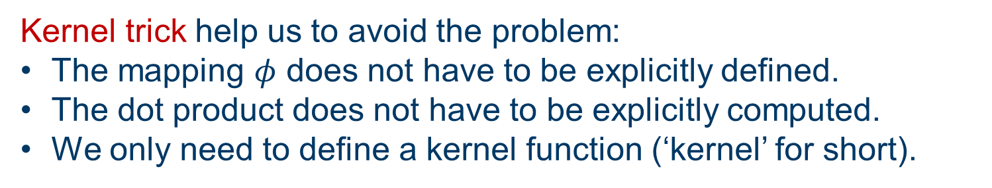


Kernel trick
Problem: Explicit feature mapping and dot product are inefficient.​
Kernel trick help us to avoid the problem:
The mapping $φ$ does not have to be explicitly defined.
The dot product does not have to be explicitly computed.
We only need to define a kernel function (‘kernel’ for short).
Kernel $k\left(x^{i},x^{j}\right)$ takes two points in the input space, and gives the dot product of their mappings in the feature space.
equivalent
$$k\left(x^{i},x^{j}\right)$$
$$(φ\left(x^{i}\right)⋅φ(x^{j}))$$
define a kernel
define $φ$, calculate dot product
Using kernel trick, we can get the result of considering $φ$ without really using it and can obtain the same result only using the data from original input space.

Slide 8

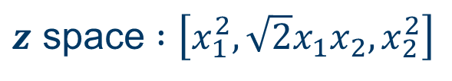
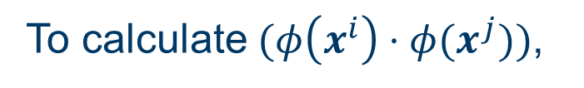
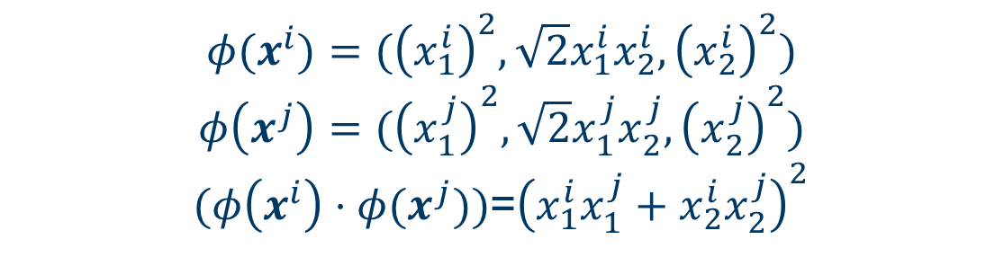
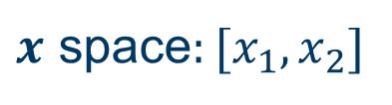
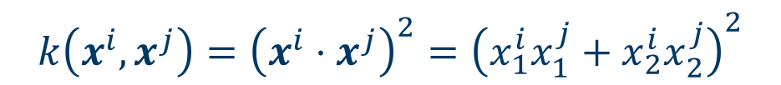
Kernel trick
Example of a 2nd-degree polynomial mapping:
$$φ$$
$x$ space$:[x_{1},x_{2}]$
$z$ space $:\left[x_{1}^{2},\sqrt{2}x_{1}x_{2}, x_{2}^{2}\right]$
To calculate $(φ\left(x^{i}\right)⋅φ(x^{j}))$,
Without kernel trick, we need to calculate the following:
$$φ(x^{i})=({\left(x_{1}^{i}\right)}^{2},\sqrt{2}x_{1}^{i}x_{2}^{i},{\left(x_{2}^{i}\right)}^{2})$$
$$φ\left(x^{j}\right)=({\left(x_{1}^{j}\right)}^{2},\sqrt{2}x_{1}^{j}x_{2}^{j},{\left(x_{2}^{j}\right)}^{2})$$
$(φ\left(x^{i}\right)⋅φ(x^{j}))$=${\left(x_{1}^{i}x_{1}^{j}+x_{2}^{i}x_{2}^{j}\right)}^{2}$
equal
With kernel trick, we only need to define a quadratic kernel: $k\left(x,z\right)={\left(x^{T}z\right)}^{2}$
$$k\left(x^{i},x^{j}\right)={\left(x^{i}⋅x^{j}\right)}^{2}={\left(x_{1}^{i}x_{1}^{j}+x_{2}^{i}x_{2}^{j}\right)}^{2}$$
We do not need to know $φ$.

Slide 9

Widely used kernels
Some widely used kernels
Linear kernel: $k\left(x,z\right)=x^{T}z$
Quadratic Kernel: $k\left(x,z\right)={\left(x^{T}z\right)}^{2}$ or $k\left(x,z\right)={\left(1+x^{T}z\right)}^{2}$
Polynomial Kernel:$k\left(x,z\right)={\left(x^{T}z\right)}^{q}$ or $k\left(x,z\right)={\left(1+x^{T}z\right)}^{q}$
Radial Basis Function (RBF) kernel: $k\left(x,z\right)=exp⁡(−γ{\left\|x−z\right\|}^{2})$
Gaussian kernel (similar to RBF kernel): $k\left(x,z\right)=exp⁡(−\frac{{\left\|x−z\right\|}^{2}}{2σ^{2}})$

Slide 10
Choose the appropriate kernel
How to choose kernel?
The choice of kernel function should be based on the nature of the problem and the characteristics of the data.
The linear kernel is mostly preferred for text classification problems as it performs well for large datasets.
Gaussian kernels tend to give good results when there is no additional information regarding data.
Use cross-validation

Slide 11
Choose kernels by cross-validation
1. Split the dataset into training set and test set in different ways.
Fold 1
Fold 1
Fold 1
Fold 2
Fold 2
Fold 2
Dataset
Fold 3
Dataset
Fold 3
Dataset
Fold 3
Fold 4
Fold 4
Fold 4
Fold 5
Fold 5
Fold 5
1-th iteration
2-th iteration
5-th iteration
Test dataset
Training dataset
2. For each candidate kernel, train and test the model on each split dataset.

Slide 12

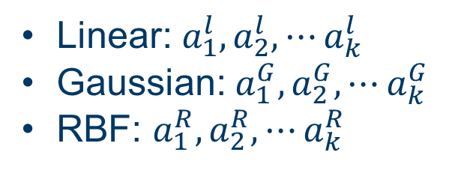
Choose kernels by cross-validation
3. Suppose we have three candidate kernels: linear, Gaussian, RBF.
After k-cross validation, we will get $k$ different estimates prediction accuracy:
Linear: $a_{1}^{l}, a_{2}^{l},⋯a_{k}^{l}$
Gaussian:$a_{1}^{G}, a_{2}^{G},⋯a_{k}^{G}$
RBF: $a_{1}^{R}, a_{2}^{R},⋯a_{k}^{R}$
4. Then we average them to get the average prediction accuracy:
${\overline{a}}^{l},{\overline{a}}^{G},$ ${\overline{a}}^{R}$
5. Choose the kernel with the best prediction accuracy.
See details in MATLAB case study.

Slide 13
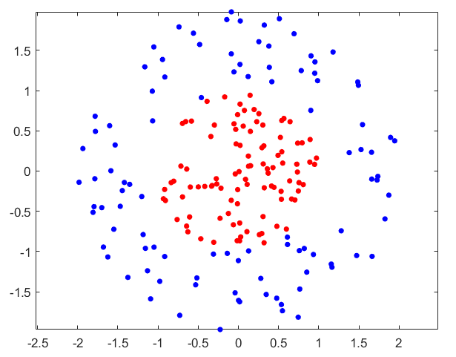
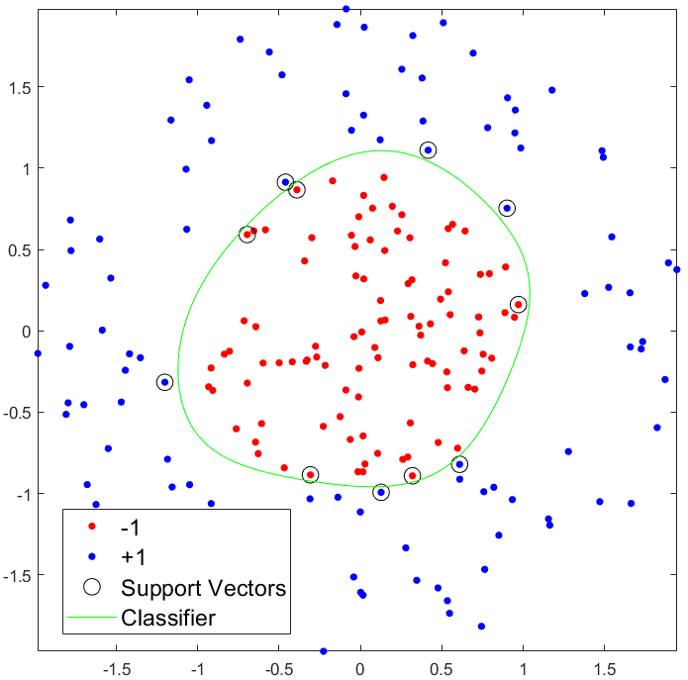
Example
Train nonlinear SVM using a Gaussian kernel

Slide 14




Thanks!
#UofGWorldChangers
@UofGlasgow

